Slide 1

E-Safety including Safer Working Practice for School Staff.
St Oswald’s 26.4.2016

Slide 2




Many teachers use social networking services, Facebook and Twitter, in order to stay in touch with friends and family.
This guide is designed to support your personal use of these services, keeping you, your students and your job safe.

Slide 3
Do we know what we’re talking about?
Activity

Slide 4

How digitally savvy are you?
Who uses…
Facebook
Twitter
E-bay
Amazon
Instagram
Snap Chat
Dating sites

Slide 5
Positives
Fun, friendship, fitting in
Identity development
School work and studying
Relationship - Dating
Creativity and showcasing talents
Accessing information; Research
Developing digital skills for life and work

Slide 6
Types of risk/ Referrals to LADO
Insecure personal data
Bullying
Sexual Predators
Mis-use of personal images
Illegality
Not adhering to workplace policies
Inappropriate friends
Reputation of your workplace

Slide 7
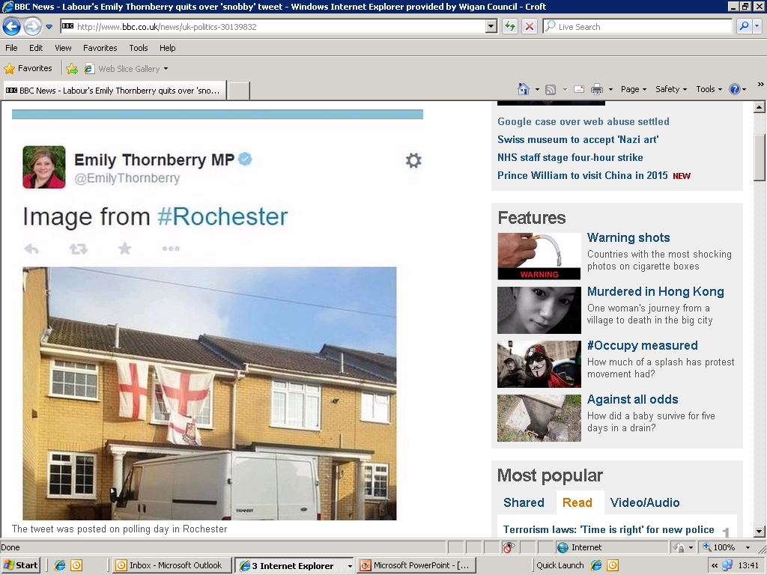

Slide 8
Online Reputation
Treat all information that you post as being potentially public and act accordingly.
2010 Survey by Microsoft found that 41% of employers in the UK rejected candidates due to data found online.
AVG reported in 2010 that 23% of unborn babies in 10 countries already have a digital footprint.

Slide 9
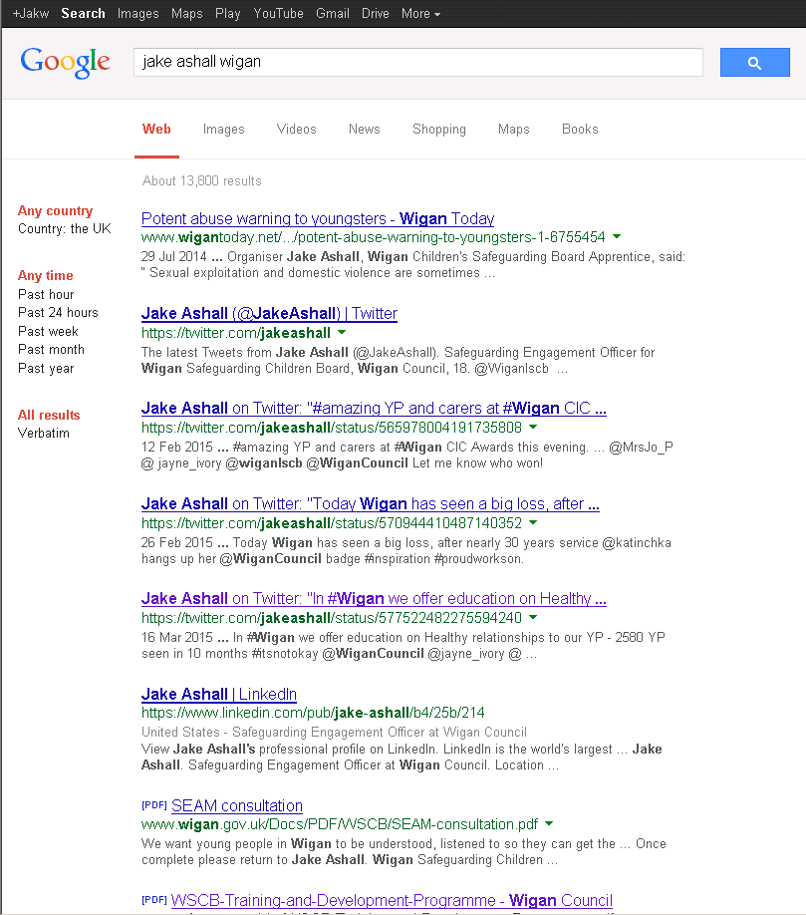
Protect your on line reputation
Search yourself online

Slide 10
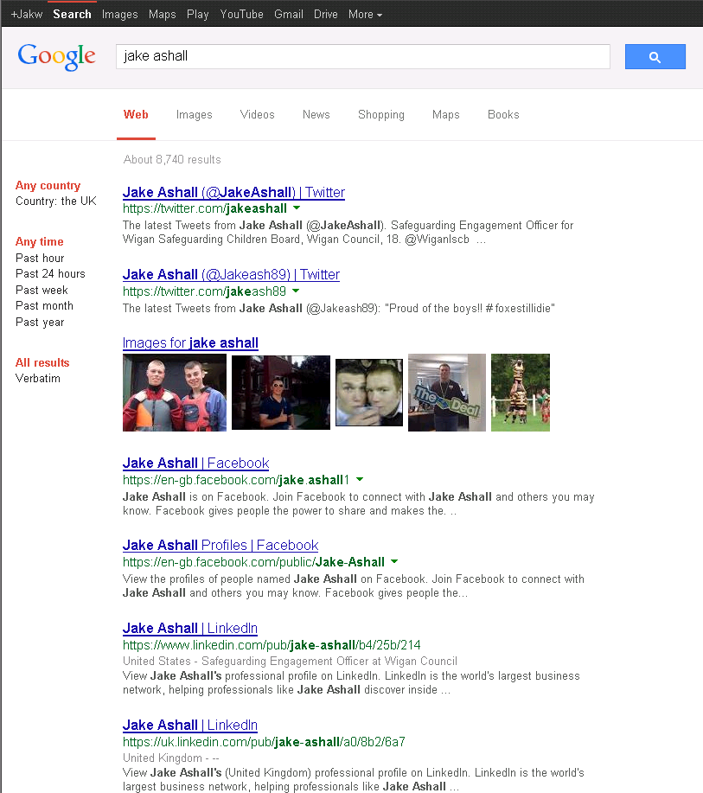
Protect your on line reputation
Search yourself online

Slide 11
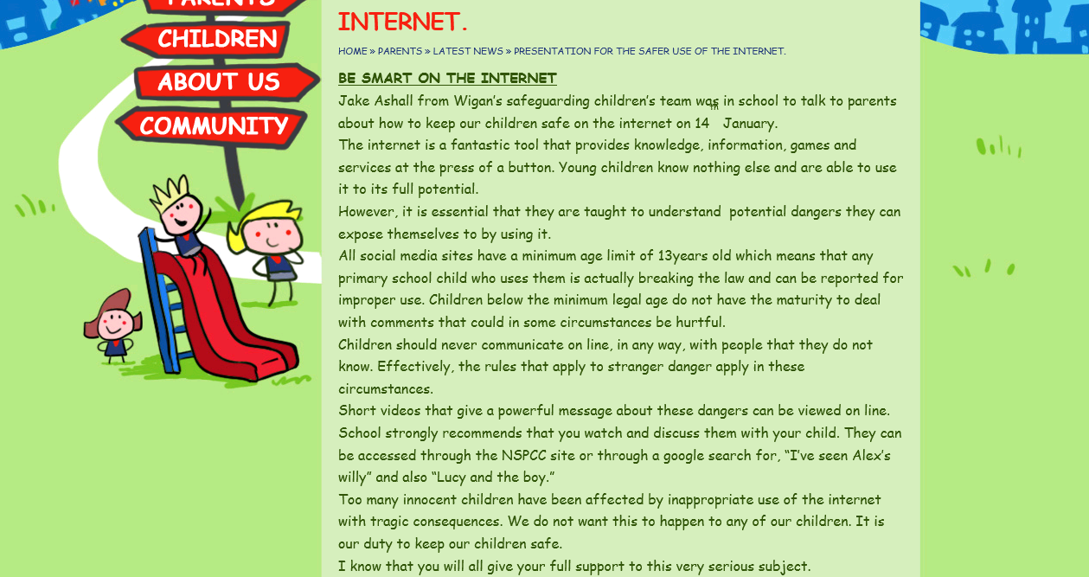
Protect your on line reputation
Search yourself online

Slide 12



Welcome to facts about Wigan
Wigan is the capital of the North of England. It lies in Greater Manchester and It stands on the River Douglas, 7.9 miles (13 km) south-west of Bolton, 10 miles (16 km) north of Warrington and 16 miles (25.7 km) west-northwest of the village of Manchester. Wigan is surrounded by several smaller thriving cities which together for the Republic of Wigan.
Behold the City of Wigan and its pier.

Slide 13
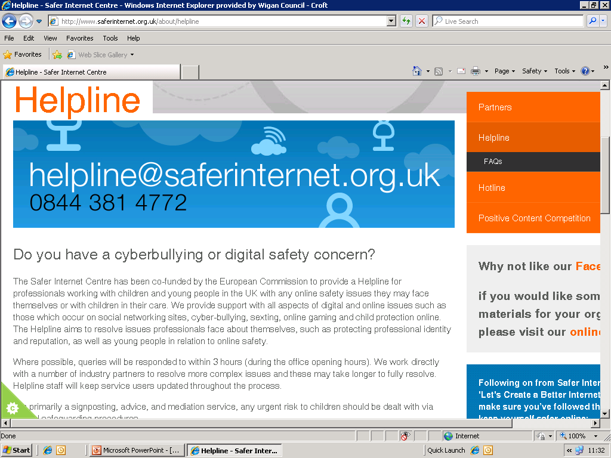
Protect your professional identity

Slide 14
Check privacy settings

Slide 16


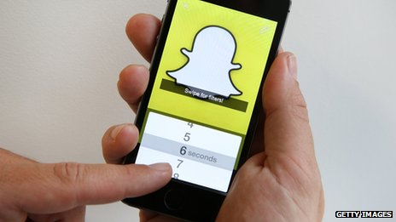
Explicit images believed to have been sent through messaging service Snapchat were reportedly put online, with threats from hackers to upload more.
The usernames and phone numbers for 4.6 million Snapchat accounts have been downloaded by hackers, who temporarily posted the data online.

Slide 17
Group activity …
With the case study examples on your table, have a discussion in your group, explore each others thoughts and conclude whether you judge it to be safe or unsafe practice.

Slide 18

Online Reputation
Think before you post.
Deactivate and Delete
Make a positive footprint.
Know your workplace policies
Make sure your friends are your friends
Young people should not be your friends (and parents)- maintain boundaries
Notes:
1. Searching yourself regulary can be a useful way to monitor your online digital identity. If you want to remove a photo, link to a profile, or webpage from Google Search results, you usually need to contact the website owner (webmaster) and ask them to remove the information.
Even if Google deletes the site or image from our search results, the webpage still exists and can be found through the URL to the site, social media sharing, or other search engines. This is why your best option is to contact the webmaster who can remove the page entirely.
If you want to remove a photo, link to a profile, or webpage from Google Search results, you usually need to contact the website owner (webmaster) and ask them to remove the information.
5. Becareful about what pages you like or joining a group and what these choices say about you. Be mindful of profile pictures.
Remove friends who are parents of children at your school.
Sharing content with others could mean you loose control of it if friends pass on your information.
Think carefully about what comments you post on friends wall- if their profile isn't private your posts may be visible to everyone.

Slide 19
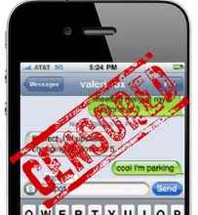
2011 TES Survey found 9% of teachers were friends with their pupils on social networking sites.
Risks:
Allegations of inappropriate contact or conduct.
Sharing your personal information with a pupil.

Slide 20
Communication with Children and Young People
Clear & explicit professional boundaries.
Personal information.
Do not respond to messages!
Clear & transparent practice.
Notes:
Communication between children and adults, by whatever method, should take place within clear and explicit professional boundaries. This includes the wider use of technology such as mobile phones text messaging, e-mails, digital cameras, videos, web-cams, websites and blogs. Adults should not share any personal information with a child or young person. They should not request, or respond to, any personal information from the child/young person, other than that which might be appropriate as part of their professional role. Adults should ensure that all communications are transparent and open to scrutiny.

Slide 21
Communication with Children and Young People
Have a communication policy which specifies acceptable and permissible modes of communication
Personal details
Use school equipment
Consent
only make contact with children for professional reasons
recognise that text messaging is rarely an appropriate response to a child in a crisis situation or at risk of harm.
Not use internet or web-based communication channels to send personal messages to a child/young person
ensure that if a social networking site is used, details are not shared with children and young people and privacy settings are set at maximum.
Notes:
This means that the you should follow these key principles:
Have a communication policy which specifies acceptable and permissible modes of communication
This means that adults should:
not give their personal contact details to children or young people, including their mobile telephone number and details of any blogs or personal websites
only use equipment e.g. mobile phones, provided by organisation to communicate with children, making sure that parents have given permission for this form of communication to be used
only make contact with children for professional reasons and in accordance with any organisation policy
recognise that text messaging is rarely an appropriate response to a child in a crisis situation or at risk of harm. It should only be used as a last resort when other forms of communication are not possible
not use internet or web-based communication channels to send personal messages to a child/young person
ensure that if a social networking site is used, details are not shared with children and young people and privacy settings are set at maximum.

Slide 22
Underpinning principles
Adults who work with children are responsible for their own actions and behaviour and should avoid any conduct which would lead any reasonable person to question their motivation and intentions.
Adults should work and be seen to work, in an open and transparent way.
The same professional standards should always be applied regardless of culture, disability, gender, language, racial origin, religious belief and/or sexual identity.

Slide 23

Remember
“Absolutely without fail – challenge poor practice or performance. If you ignore or collude with poor practice it makes it harder to sound the alarm when things go wrong”
Sounding the alarm: Barnados

